Slide 1
SKILL
TRACKER

Slide 2
KAVYA S AMIN
NISHITHA LAKSHMI
SANATH ACHARYA
U KRISHNAKANTH KINI
YASHWIN GANESH
TEAM

Slide 3
INTRODUCTION
Skill Tracker is a responsive, singe page web application equipped to aid HR Managers to search for employees within the corporation based on their skills.

Slide 4
PROBLEM STATEMENT
John Demphey works in an IT company. He is a new age HR Manager .
Few of his responsibilities include the following:
Search associate: John will be able to search associate with following criteria
SKILL
NAME
EMAIL
COUNTRY

Slide 5
Add new Associate
View and Edit Associates
Add New Skill Category whenever the need arises.

Slide 6


USERS
HR MANAGER
ASSOCIATES

Slide 7
TECHNOLOGY STACK
Front end
HTML 5
CSS 3
Middleware
Java
Back end
MySQL
TypeScript
Angular 8
JavaScript
Bootstrap 4
Spring Boot
Eureka Discovery Client
Feign-Hystrix Client
JPA
Hibernate

Slide 8
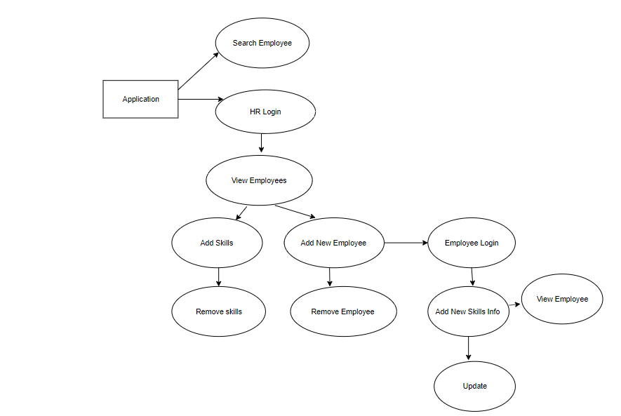
APPLICATION FLOW DIAGRAM

Slide 9
DEMONSTRATION

Slide 10
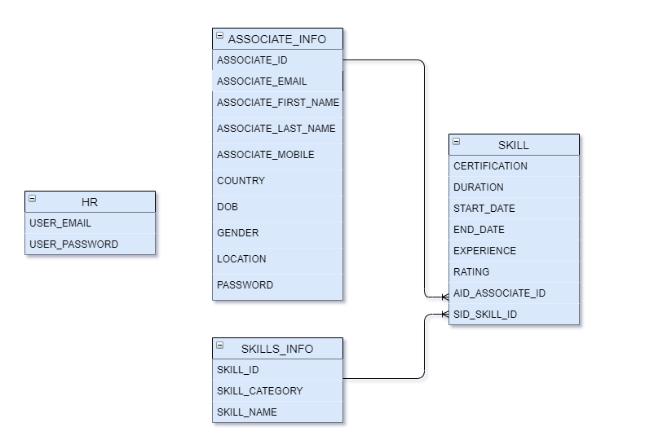
DATABASE ARCHITECTURE

Slide 11
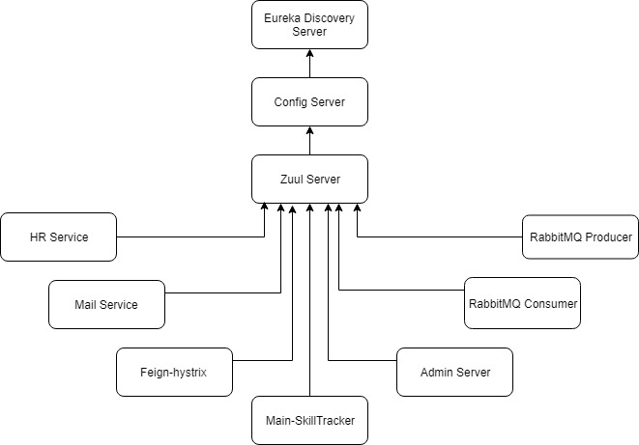
MICROSERVICE ARCHITECTURE

Slide 12
TESTING
JUnit Jupiter (JUnit 5)
Mockito

Slide 13
DEPLOYMENT
Database:
skilltracker-1.cyi7sno1sh8z.us-east-2.rds.amazonaws.com/skills
Cloud Foundry Pivotal:
https://skilltracker1.cfapps.io/

Slide 14
THANK YOU

